Slide 1
Control of movement and balance

Slide 2
Control of movement
Involves the coordination of the motor association area and primary motor area of the cerebral cortex, the cerebellum and the muscles.

Slide 3
Motor association area
Plans behaviour. Make a program for a planned movement such as kicking a ball and sends it to the primary motor area. Sends this program to the primary motor area.

Slide 4
Primary motor area
Sends nerve impulses through the brain stem, and spinal cord targeting a specific muscle with the instructions.
The primary motor area is divided into the various parts of the body containing muscles that are controlled by the motor area.

Slide 5
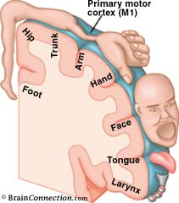
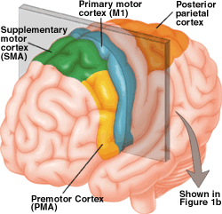

Slide 6
Upper and lower motor neurons
Upper motor neurons – carry nerve impulses away from the primary motor area. This creates a connection between the brain and the appropriate level of the spinal cord.
Lower motor neurons – will carry the impulses from the spinal cord to the muscles.

Slide 7
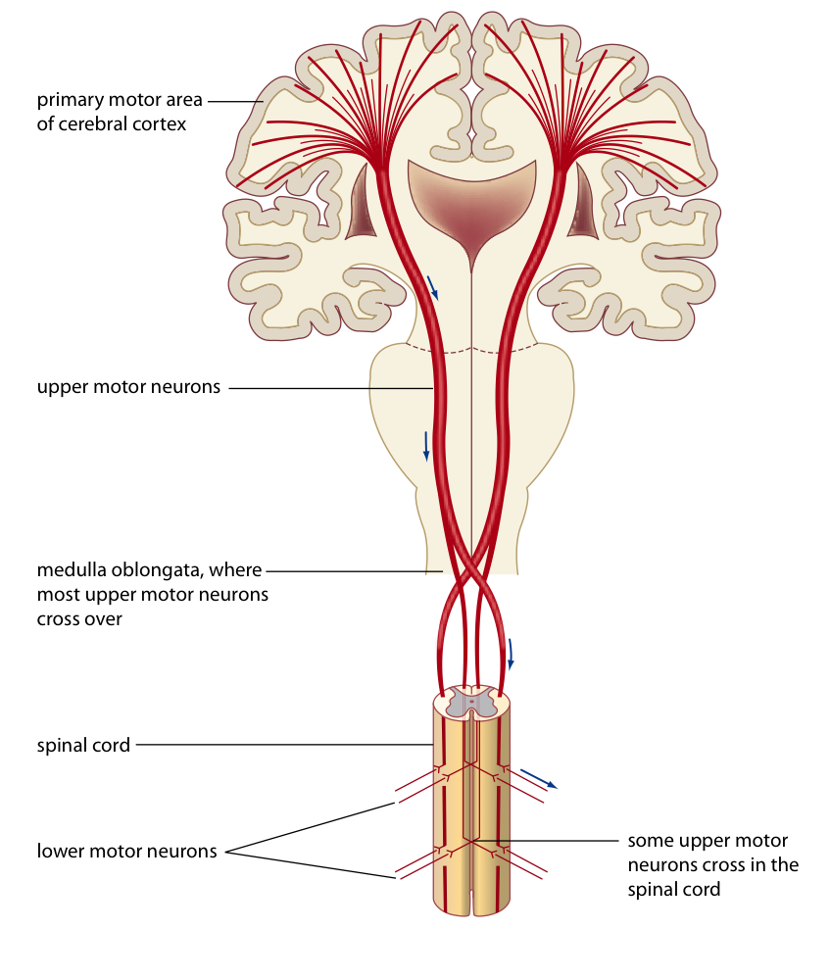

Slide 8
Cerebellum - movement
The cortex sends impulses to the cerebellum about muscle contraction.
The cerebellum also receives information from:
The inner ear
Eye
Muscle and joint receptors
The cerebellum coordinates all of this information and creates a smooth coordinated movement for complex movements such as walking, throwing or jumping.

Slide 9
Cerebellum - movement
Using this information the cerebellum critiques a person’s intentions and their actual performance.
This allows you to practice and skill and to improve the execution of a skill.
Babies and young children display jerky and uncoordinated movement due to the cerebellum being undeveloped as yet.

Slide 10
Cerebellum - balance
Balance requires constant contraction and relaxation of muscles while walking, siting or running.
The cerebellum receives input from various senses regarding balance:
The cerebrum (awareness of what the body is doing)
Inner ear: semicircular canals – movement of head, saccule and utricle – position of the head
Eyes – able to observe body's position
Pressure receptors in skin – how much pressure is being put on the different parts of the body. Especially feet when standing, running or walking
Stretch receptors – how the body is moving around the joints
The cerebellum directs muscle movement in order to maintain balance.

Slide 11
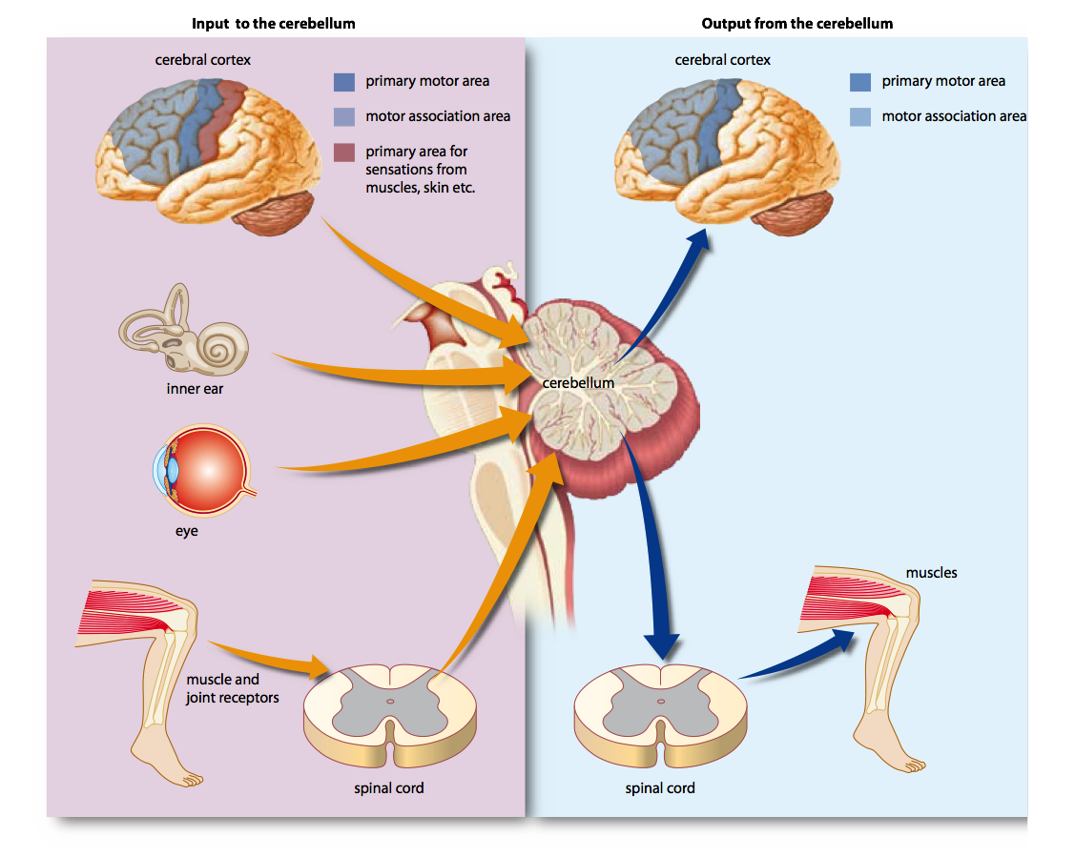
Cerebellum - balance

Slide 12
Reflexes
Reflex: rapid, automatic response to a change in the external or internal environment:
Stimulus – triggers the reflex
Involuntary – occurs without conscious thoughts
Rapid – only a small number of neurons are involved
Stereotyped – the same response occurs every time

Slide 13
Reflexes
Most reflexes are coordinated by the spinal cord. These are called spinal reflexes and make up a spinal reflex arc.
Receptor: reacts to a change in the internal or external environment. Initiates a nerve impulse in the sensory neuron.
Sensory neuron: carries impulse to the CNS
Synapse: may be a motor neuron or may be an interneuron which passes the impulse on to a motor neuron.
Motor neuron: carries a nerve impulse to an effector
Effector: receives the nerve impulse and carries out the response (usually muscle cells or secretory cells)

Slide 14
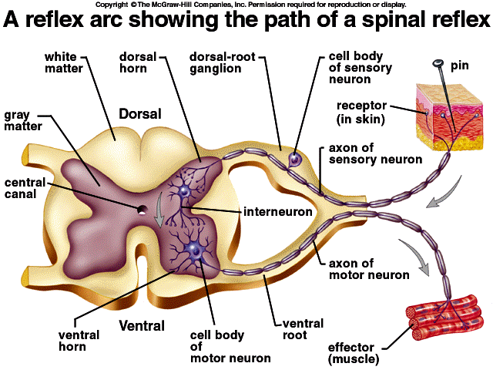

Slide 15
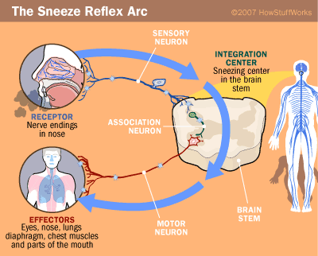

Slide 16
Learned reflexes
Acquired reflexes: complex motor patterns that can be learned. Maintaining balance while riding a bike, catching a ball.
These are learned through practice/repetition.

